Slide 1

Price Premiums in Sequential Electricity Markets
Team 2
Julian Cornea, Kim Ferres, Rufin Korbmacher, Johannes Weyers
Notes:
2.2 Project Presentation (20 minutes)
Each team presents their project to the class on session #14. The project is based on the ideation
submission, where the idea is then developed into a data mining solution with nal recommendations.
Create the following slides (10 slides):
1. Cover: Informative title, team number and member names

Slide 2
Business Problem
intraday
market
day-ahead
market
Client | Electricity trading company
Problem | Turnover for sold electricity on sequential markets is not optimal
Goal | Maximize price for traded electricity by splitting the sales between the sequential short-term markets more effectively
Notes:
2. Business problem (stakeholder, challenge/opportunity, humanity considerations)
Price premium

Slide 3
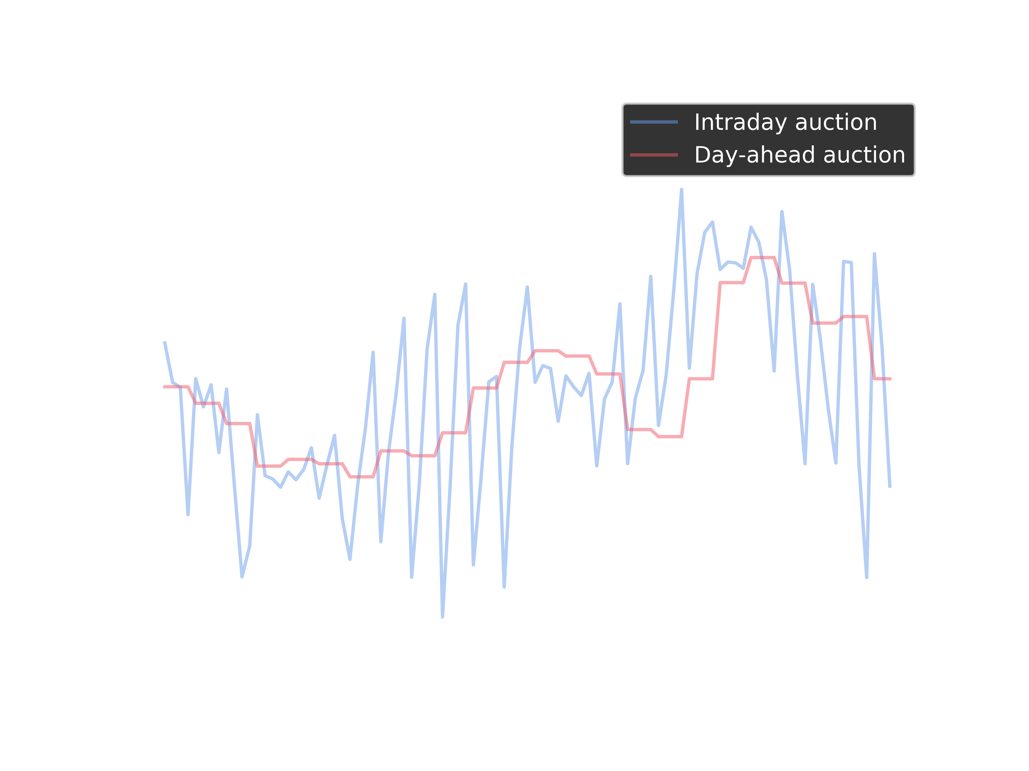
Data Mining Problem
Explanative mode (supervised):
Relationship between the price for both auctions
Predictive model (supervised):
Forecast for the direction of price differences
Notes:
3. Data mining problem (supervised/unsupervised, explanatory/predictive, how to be deployed)

Slide 4
Data Description
datetime | price | consumption | price_dayahead | consumption_dayahead
2016-01-01 06:00:00 | 8.53 | 332.3 | 15.86 | 11448.6
2016-01-02 01:30:00 | 11.0 | 359.3 | 16.57 | 11591.2
2016-01-02 10:30:00 | 17.35 | 205.7 | 24.3 | 13998.2
2016-01-02 11:15:00 | 24.32 | 178.7 | 25.05 | 14276.0
2016-01-05 07:15:00 | 37.46 | 274.5 | 38.32 | 13842.7
70176 instances during the years 2016 and 2017
→ 15-minute intervals for intraday auctions
→ hourly intervals for day-ahead auctions
Notes:
4. Data description (what is a row? Output and input variables; partitioning)

Slide 5


Data Preparation
weather Daily average temperature in Celsius Daily maximum temperature in Celsius Daily minimum temperature in Celsius Number of freezing days Number of icy days Monthly rain volume in mm Number of rainy days Average of daily sunshine hours Average monthly wind speed in km/h Monthly snow days Average of the daily snowfall in cm | market participants
holidays | price premium
$${FP}_{i,t}=F_{it}−S_{i,t+1}$$
Notes:
4. Data description (what is a row? Output and input variables; partitioning)

Slide 6
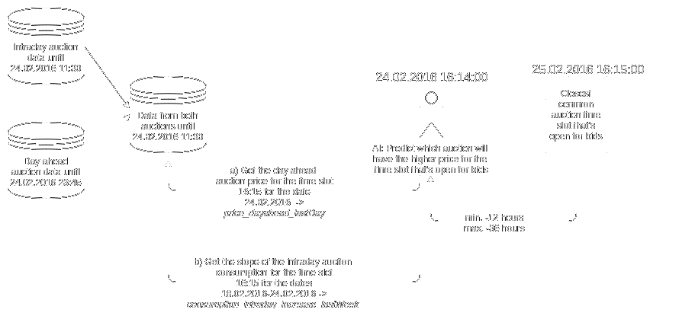
Data Preparation: Predictive
One hot encoding of the timestamp column
Binary conversion of the price premium
Adding the most important historical auction data for each timeslot

Slide 7
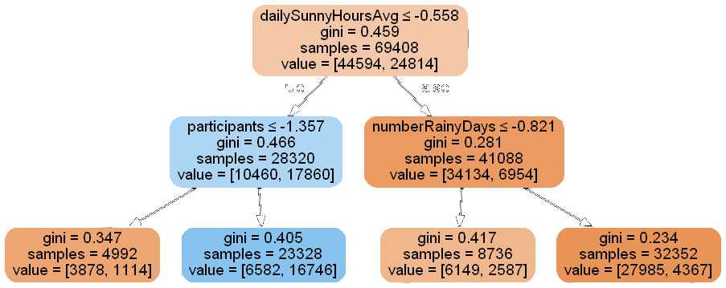
Methods
Descriptive:
Decision Tree
Predictive:
Stochastic Gradient Descent (SGD) Classification
Binary Support Vector Classification (SVC)
Gaussian Naive Bayes
Logistic Regression
Recurrent Neural Network (RNN)
Decision Tree
Autoregressive-Moving Average (ARIMA)
Random Forest
Soft/Hard Voting Ensemble

Slide 8
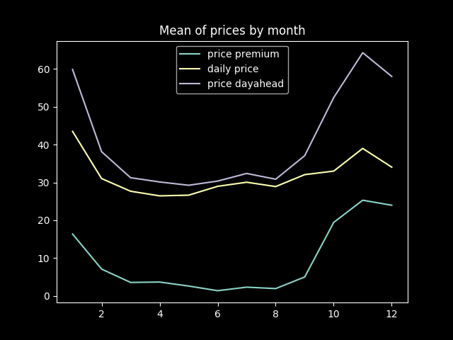
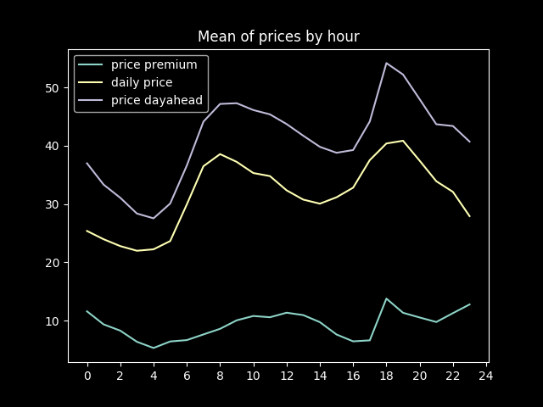
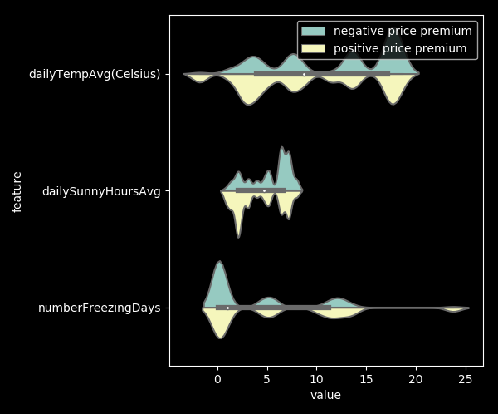
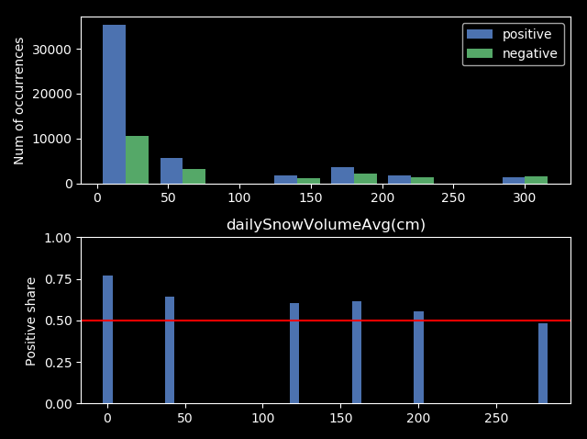
Evaluation: Descriptive

Slide 9
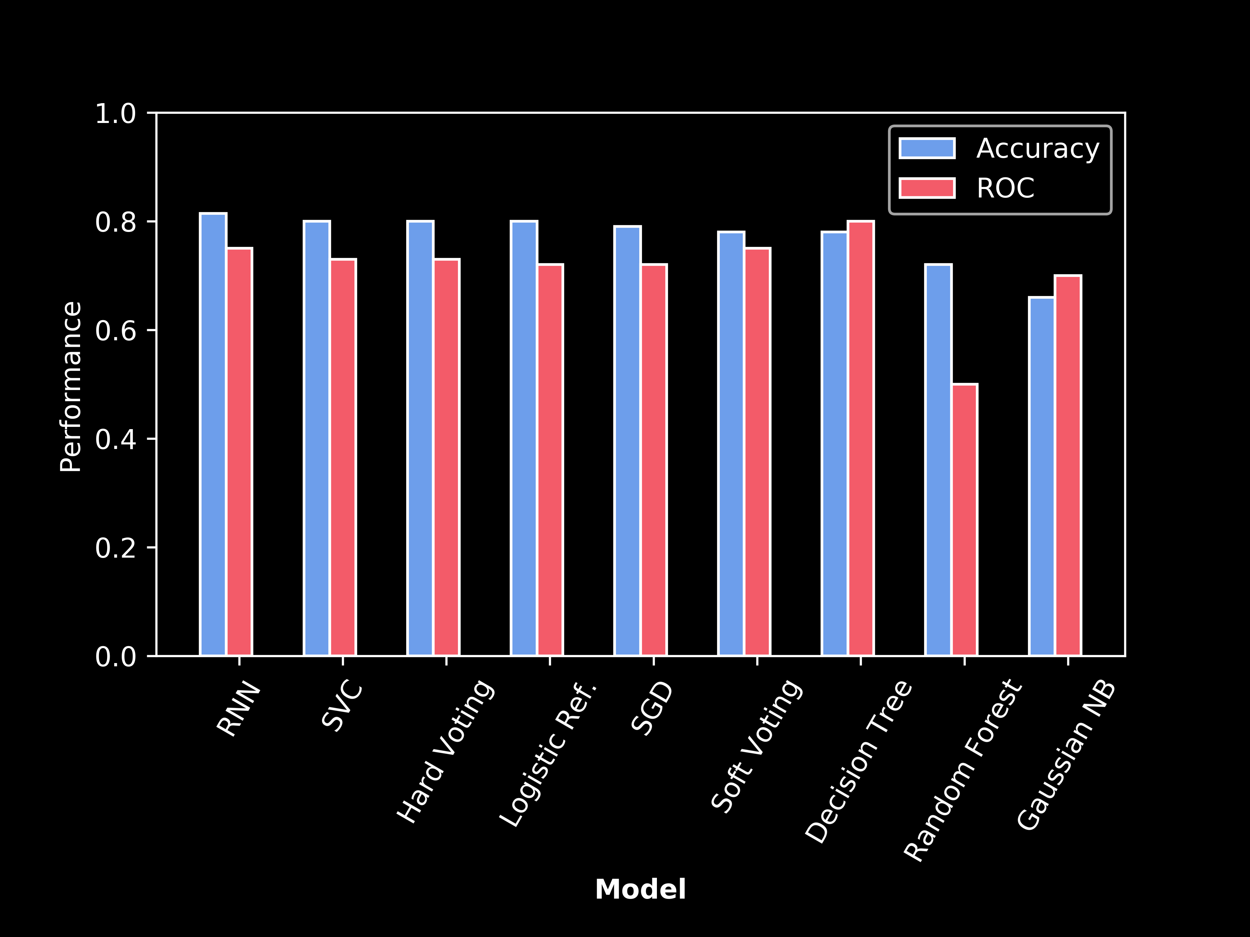
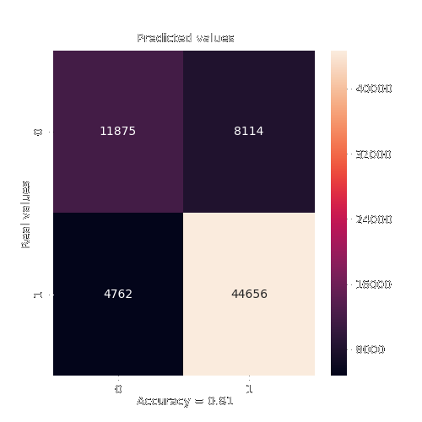
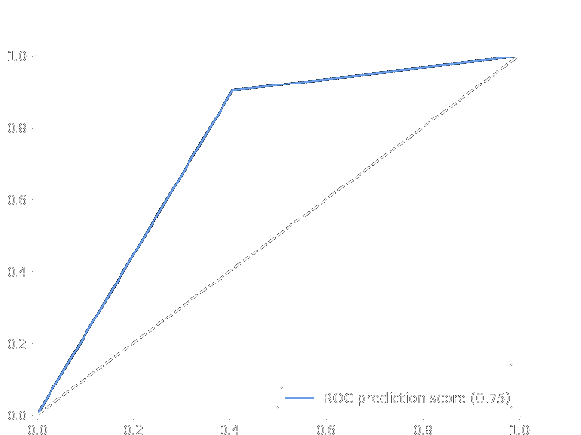
Evaluation:
Predictive
ROC: 75%
Acc. : 81%
RNN:
ROC
11875
8114
4762
44656

Slide 10
Recommendations
Encountered problems:
Switch to daylight saving time and the switch back to standard time
For use in a productive environment:
The predictive model would have to be a reinforcement learning agent
Predictions would have to use predicted weather data
Model performance has to be monitored to prevent performance degradation
The historical auction data columns could be implemented in another way to optimize performance
Notes:
7. Recommendations (what should the client be aware of? problems you encountered, suggestions for future data collection or analysis, etc.)

Slide 11
Thanks!
ANY QUESTIONS?

Slide 12
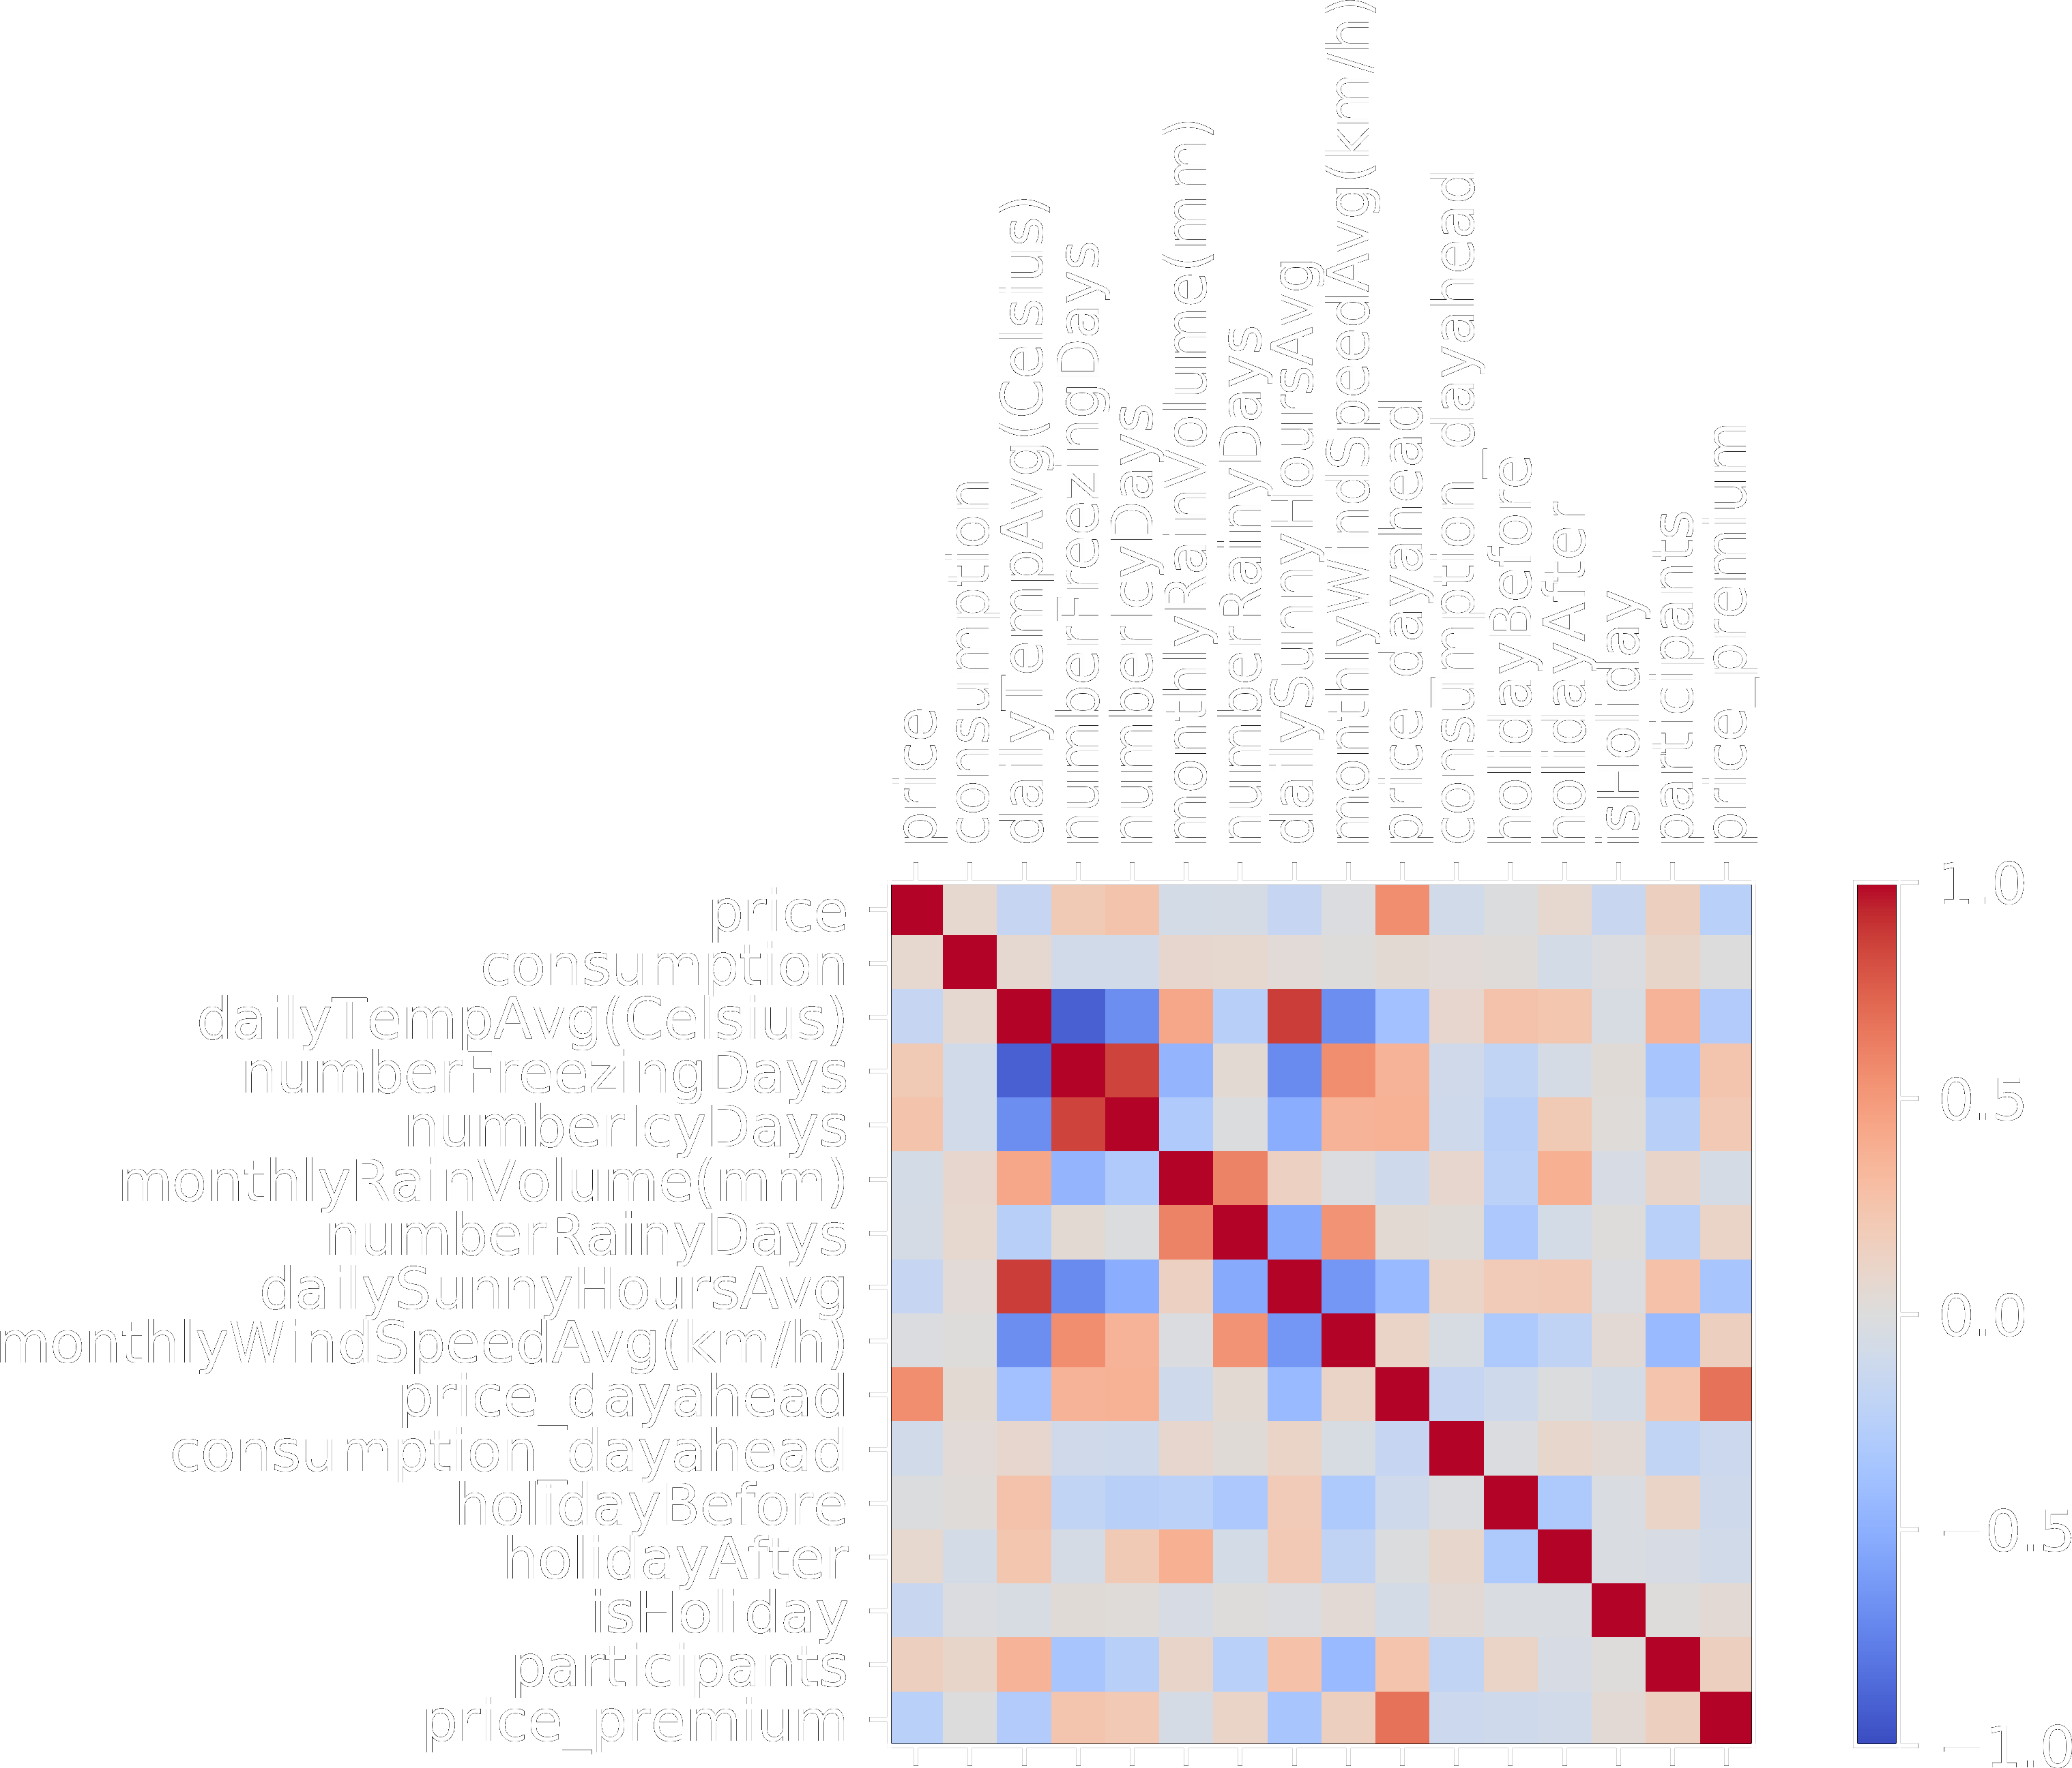

Slide 13
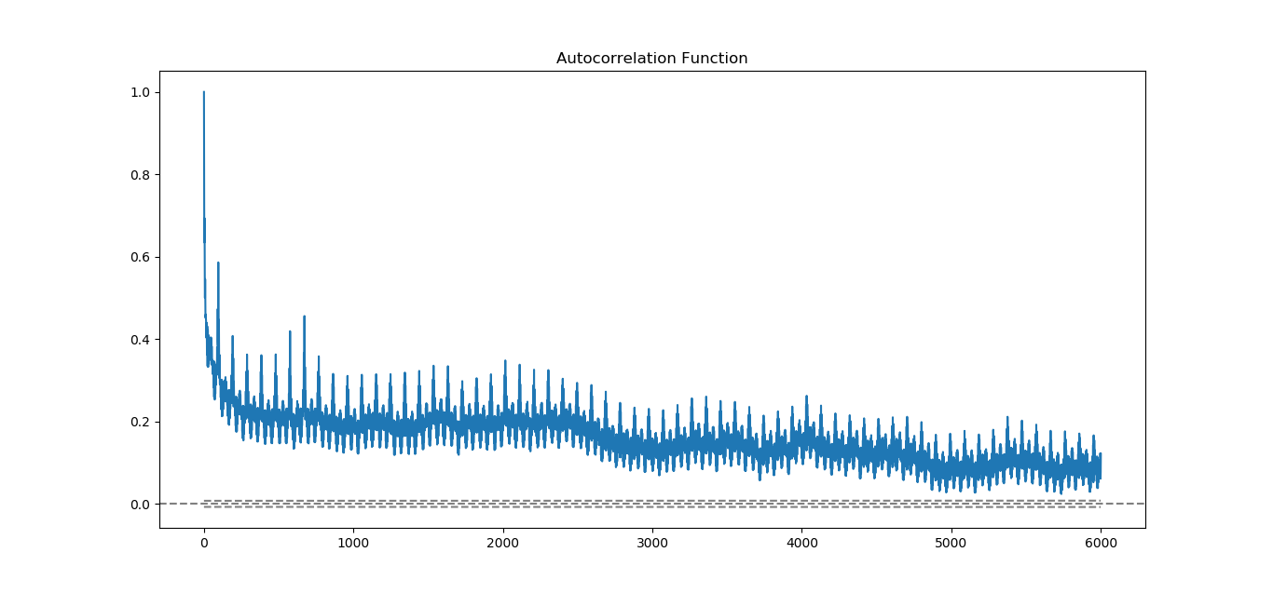
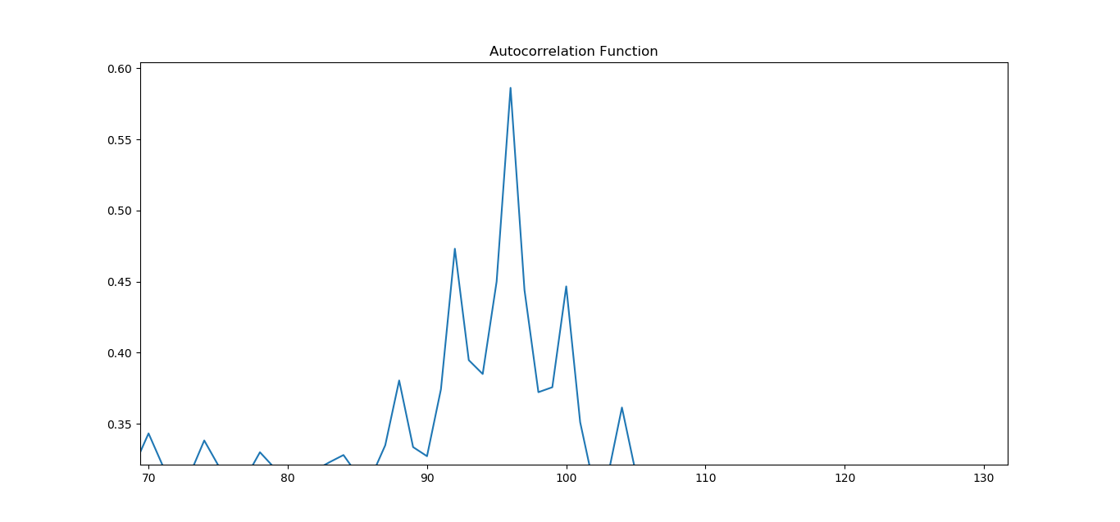
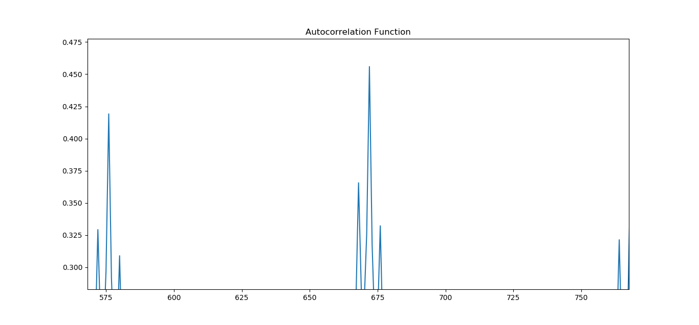
Evaluation: Descriptive
daily
weekly

Slide 14
Evaluation:
Expected profit
Prediction | Actual | Cash change
1 | 1 | +
1 | 0 | -
0 | 1 | -
0 | 0 | +
Expected profit per Mwh: 0.24 € (TC 78% accuracy)

